Slide 1
Using WordPress to Contextualize and Publish Digital Repository Content
Sarah Sweeney
Digital Repository Manager
Northeastern University Libraries, Digital Scholarship Group

Slide 2
Our Questions
How can we represent the longevity and sustainability of digital humanities research projects as a shared responsibility that begins with fundamental project design decisions and data creation strategies, rather than purely an obligation of the library?
And how can we create a culture of partnership among faculty and student researchers and library staff, in which the challenges of digital curation are understood as shared research challenges rather than functional details of purely “technical” implementation?

Slide 3
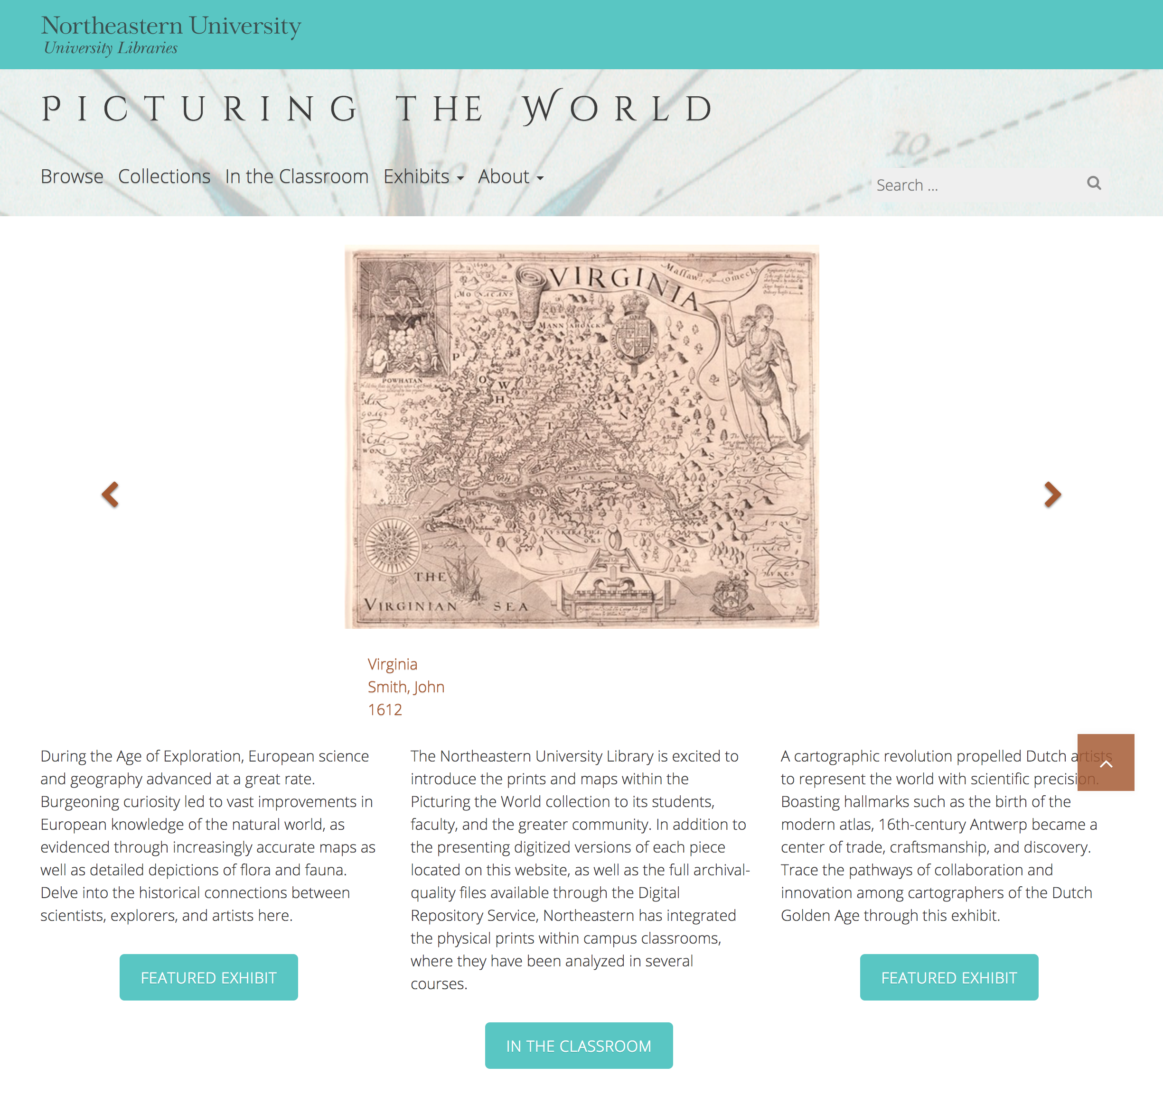
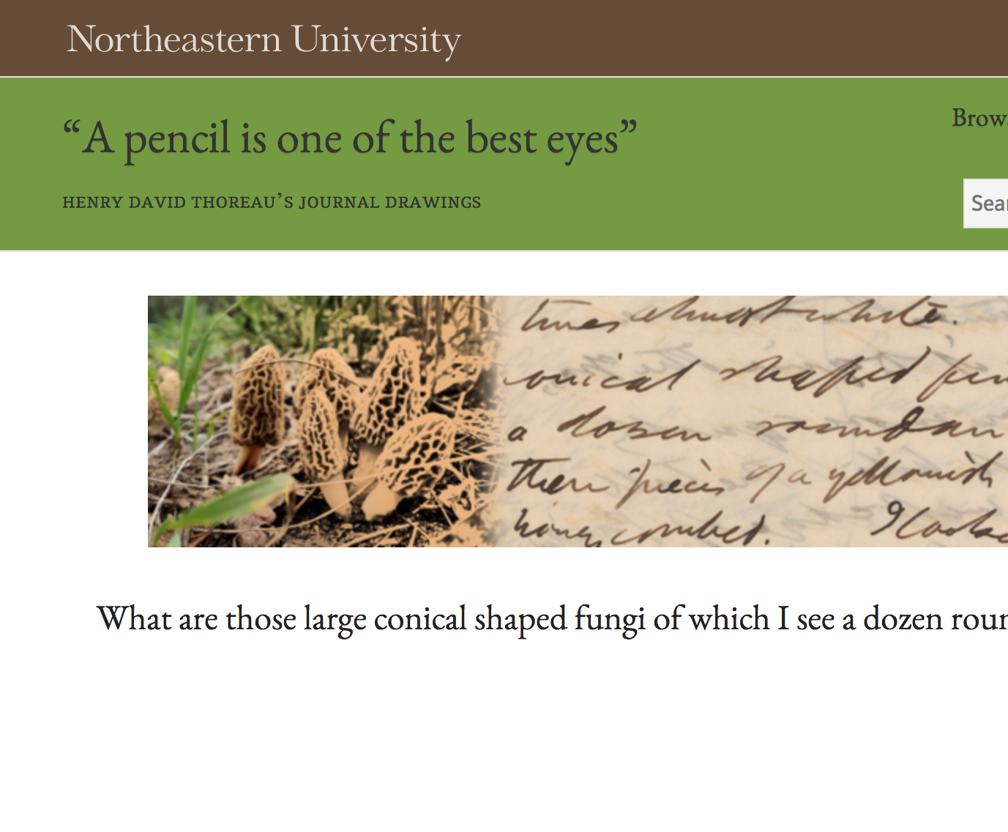
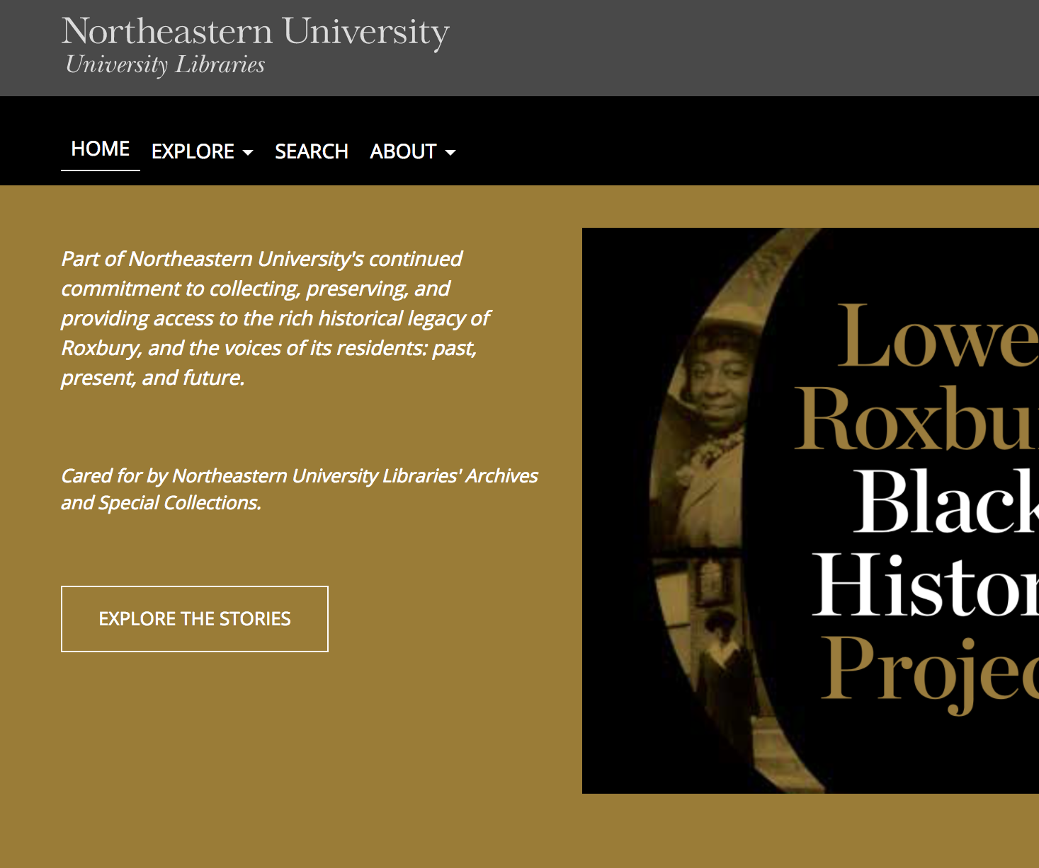
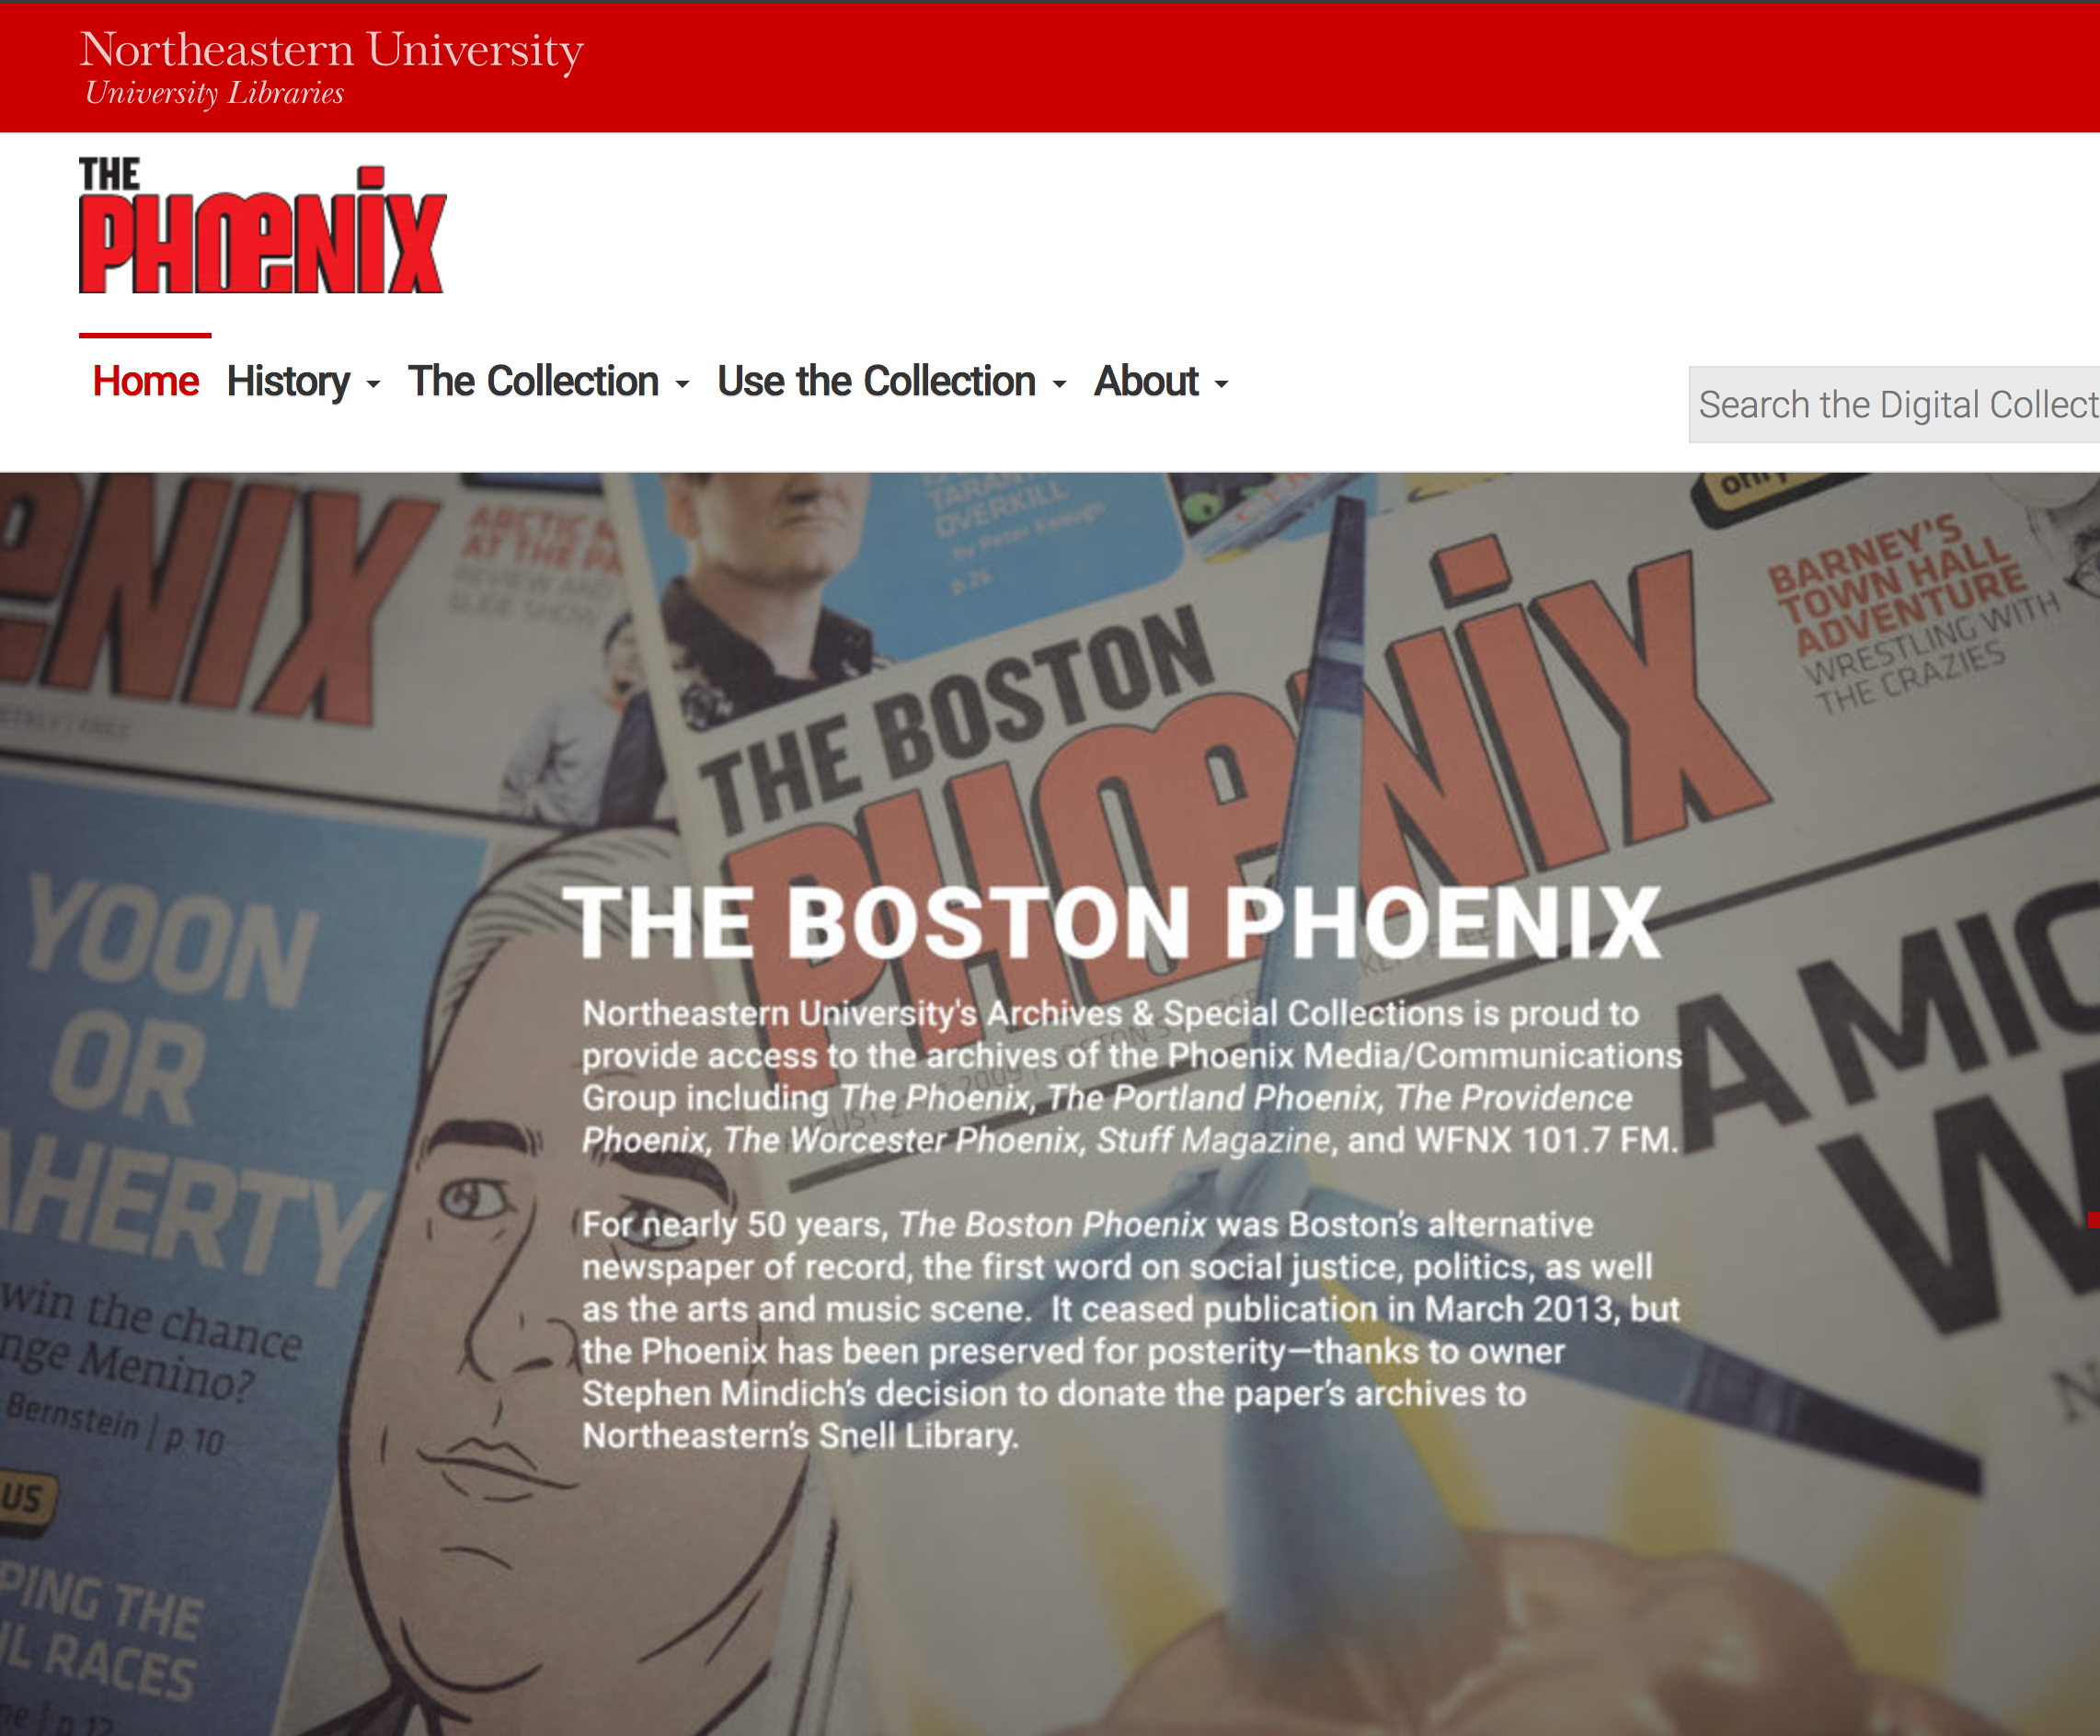
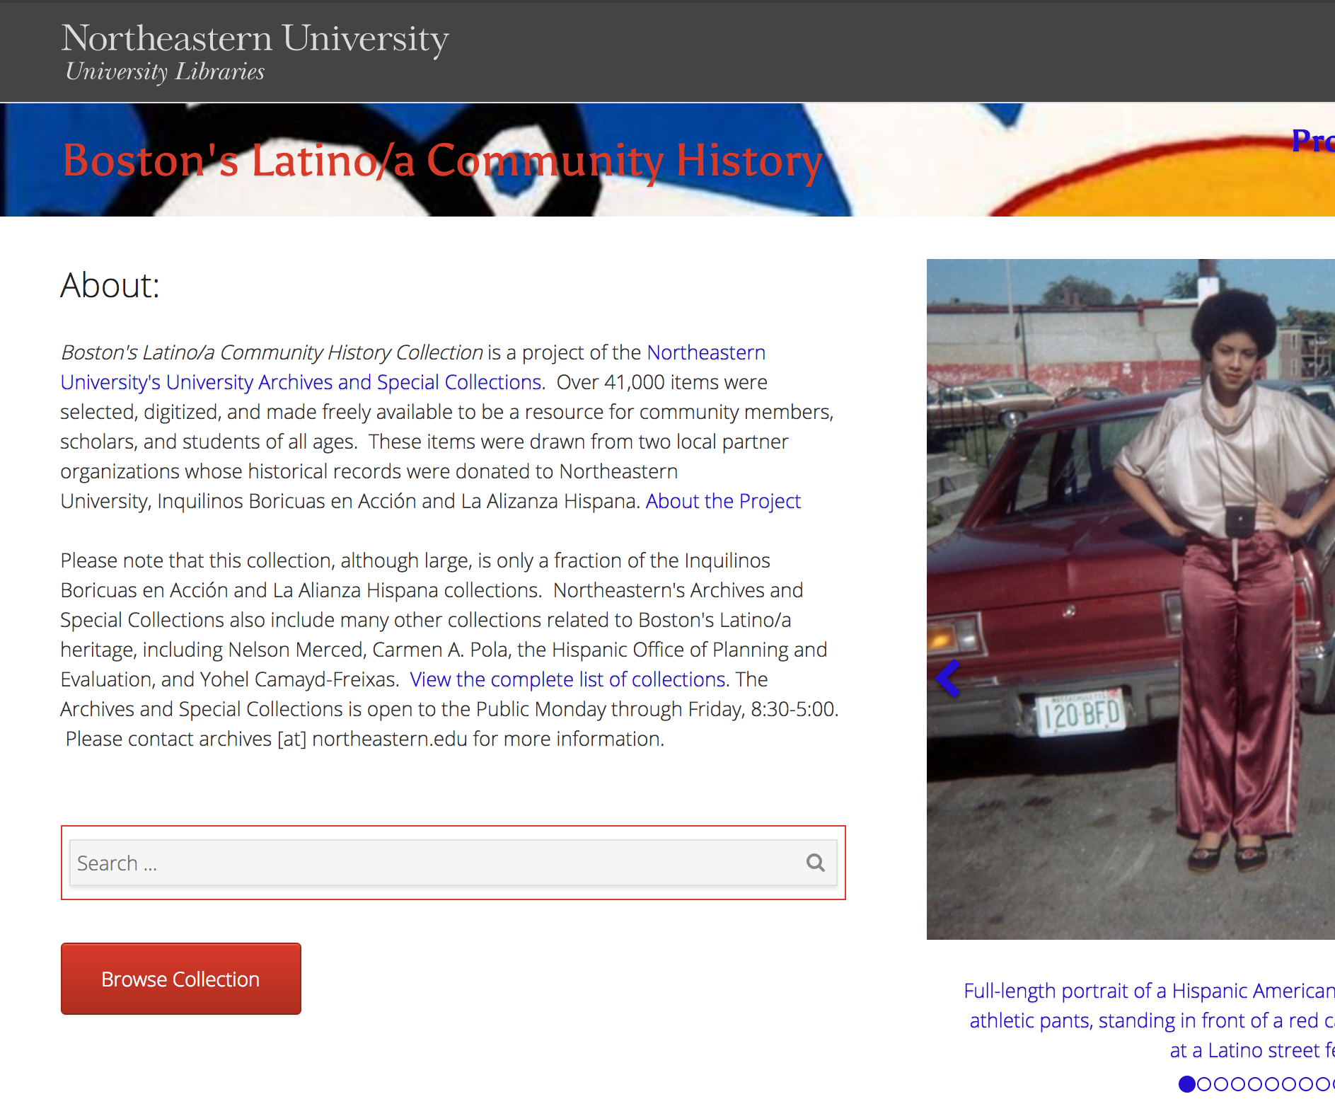
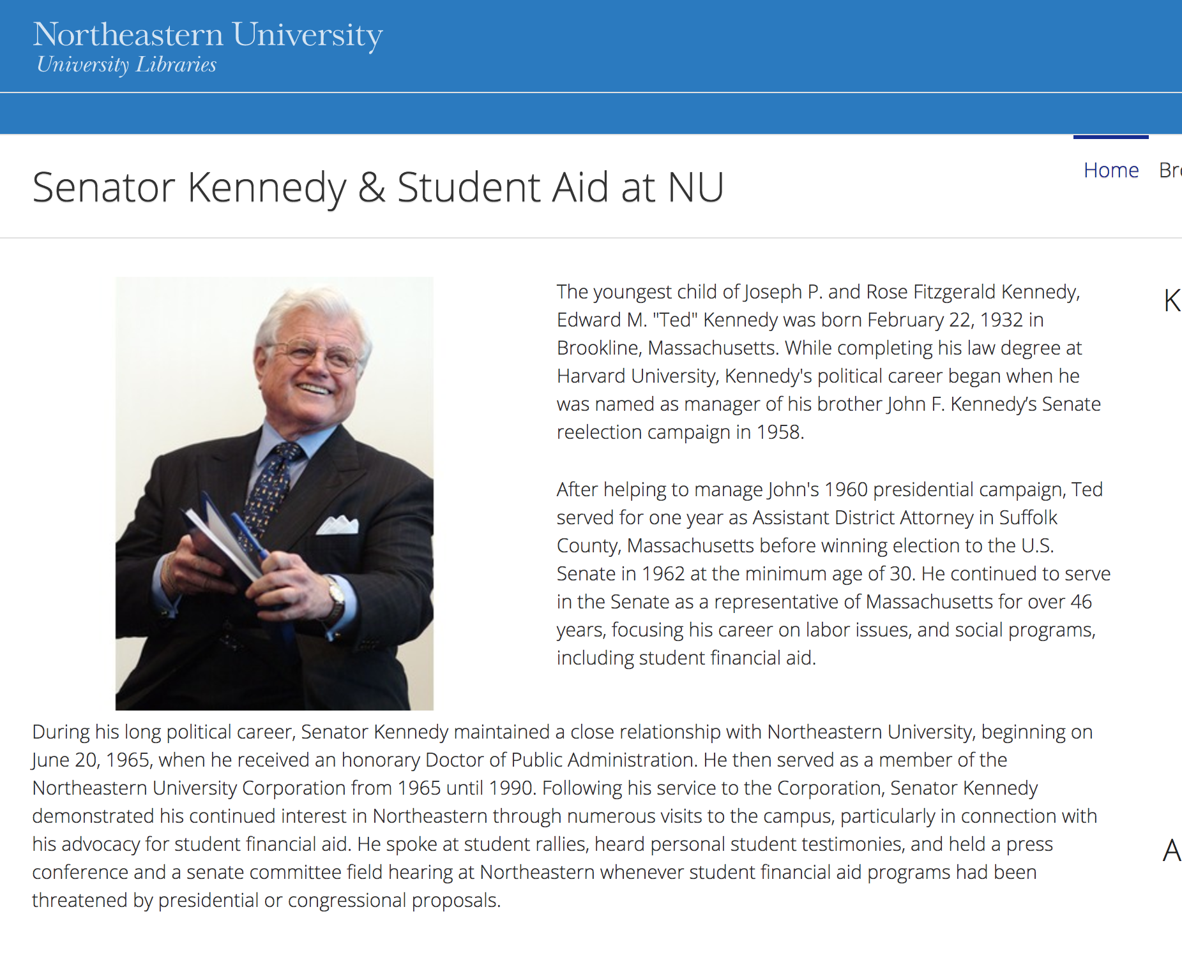
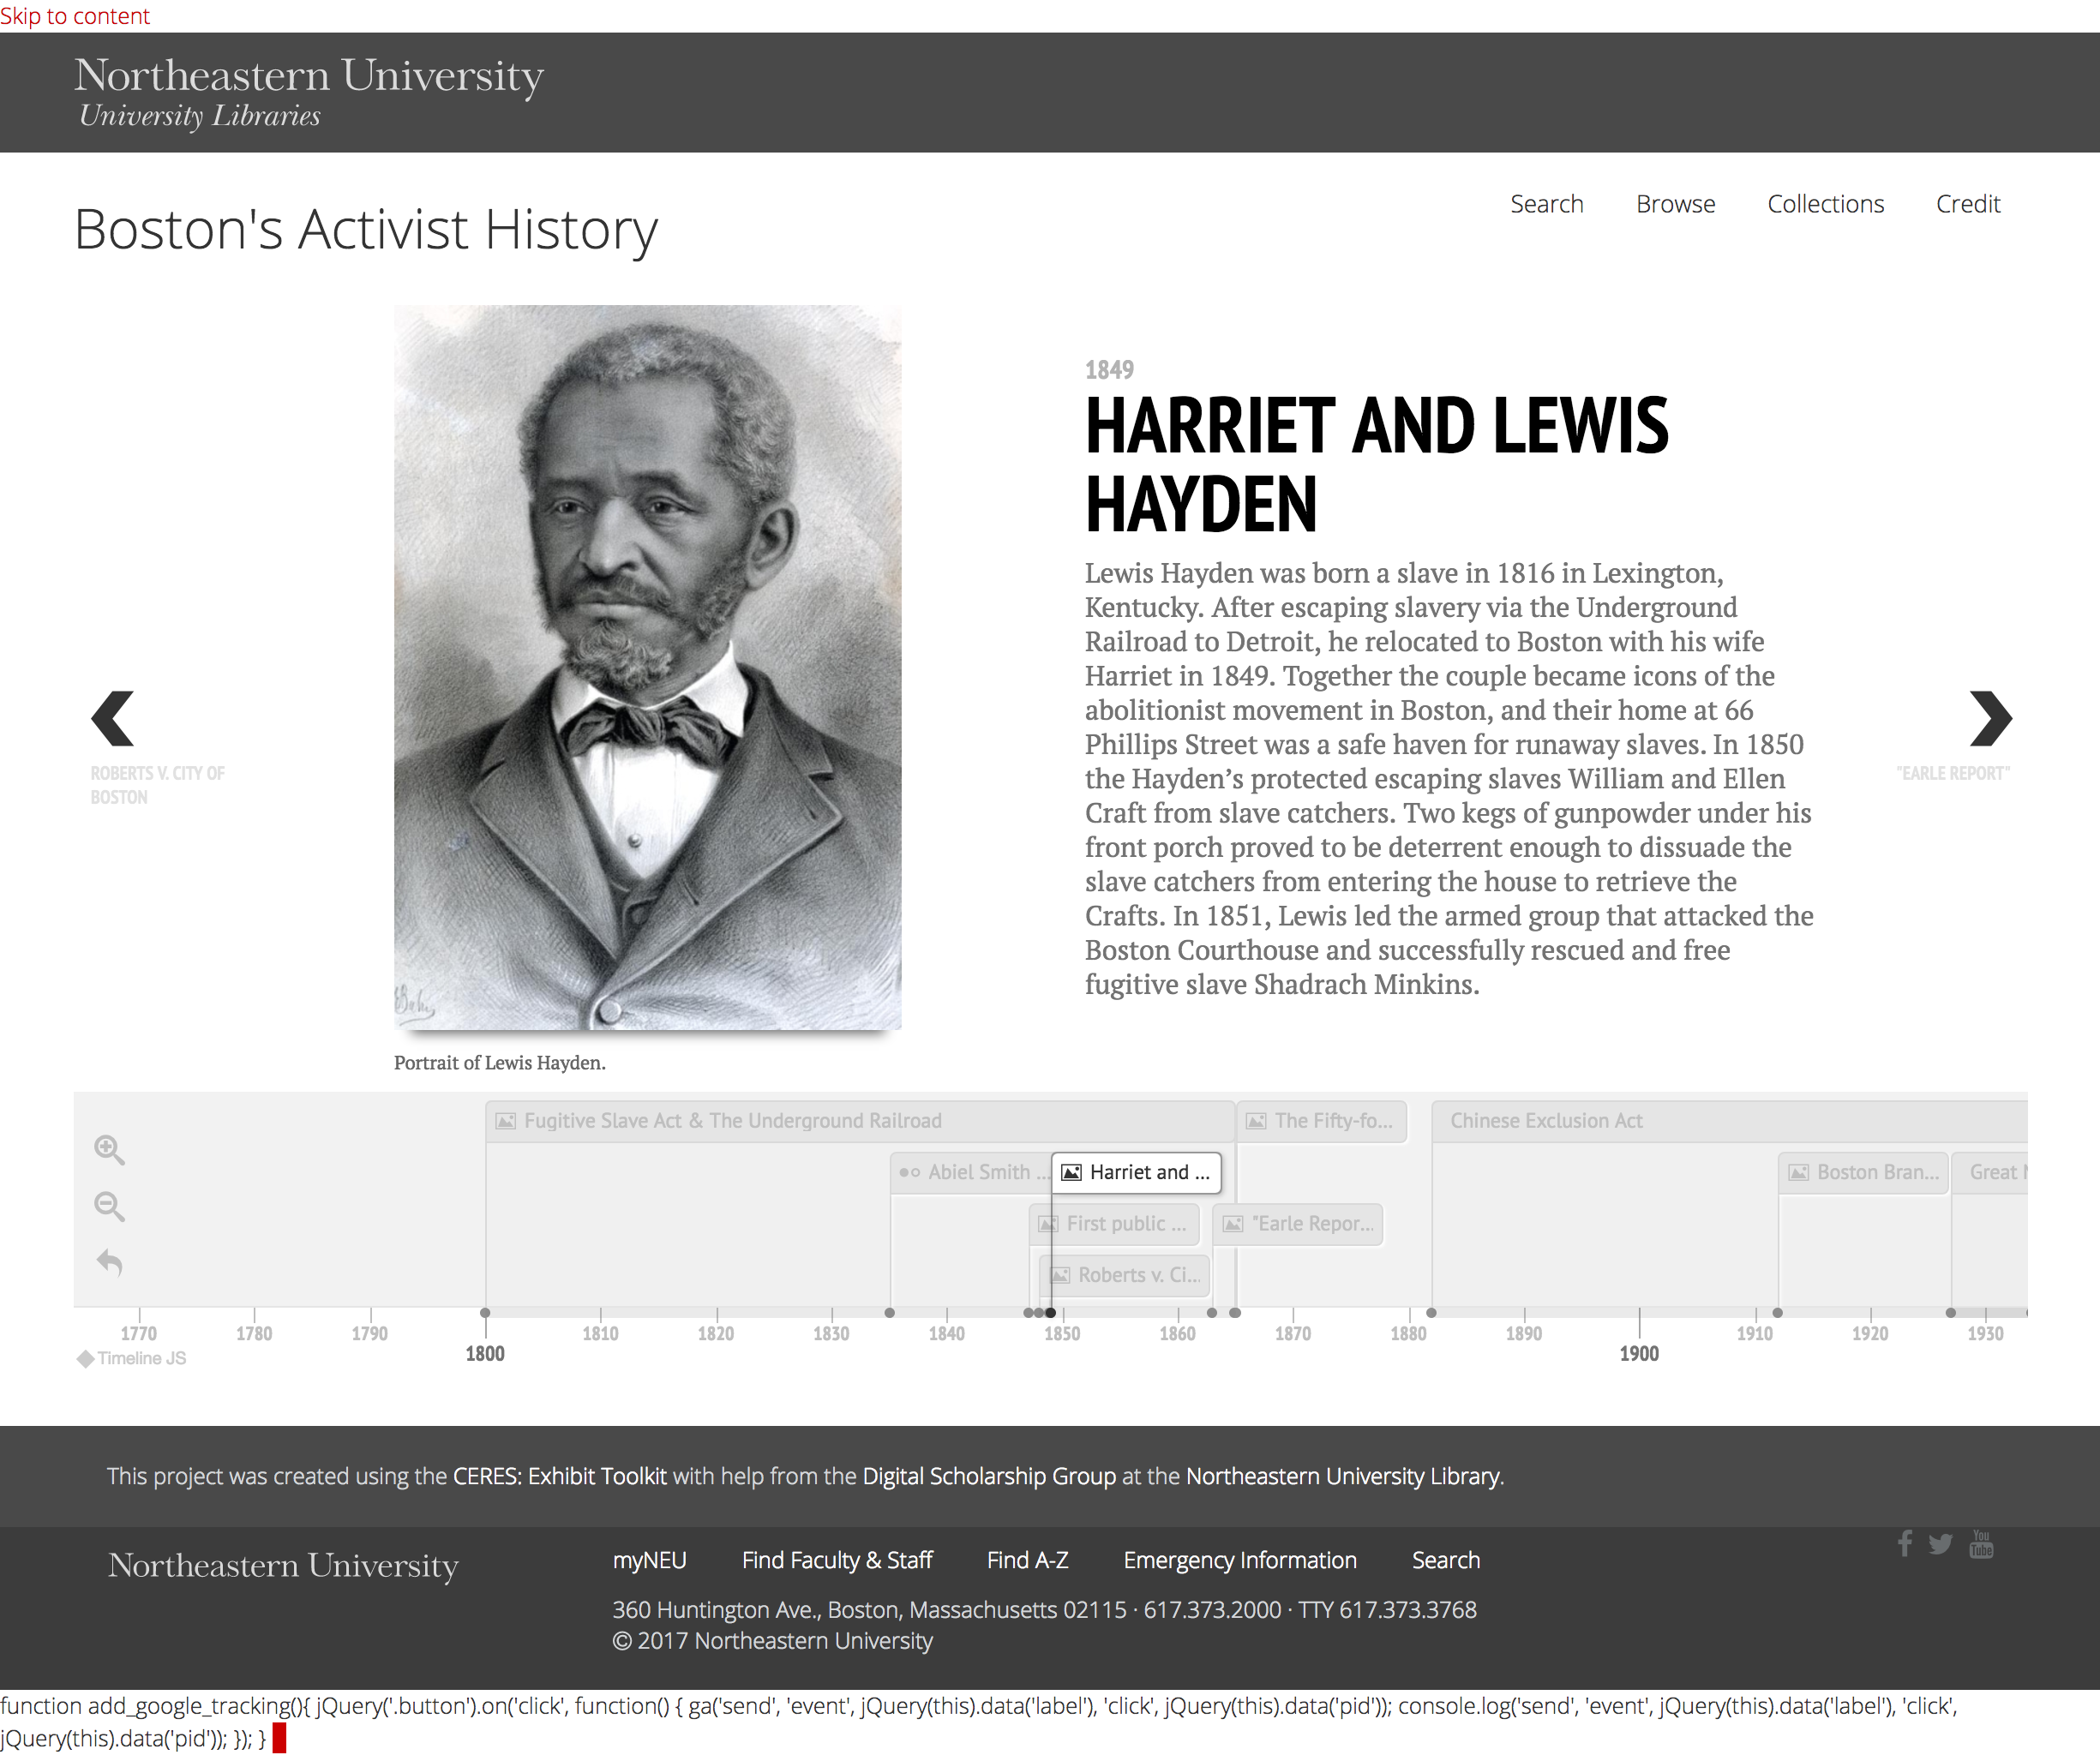
Our Answer
The Community Enhanced Repository for Engaged Scholarship: CERES

Slide 4
Collaborative Development Principles
Support systems, not individual projects.
Materials should be curatable and usable.
Development is a shared research undertaking.

Slide 5
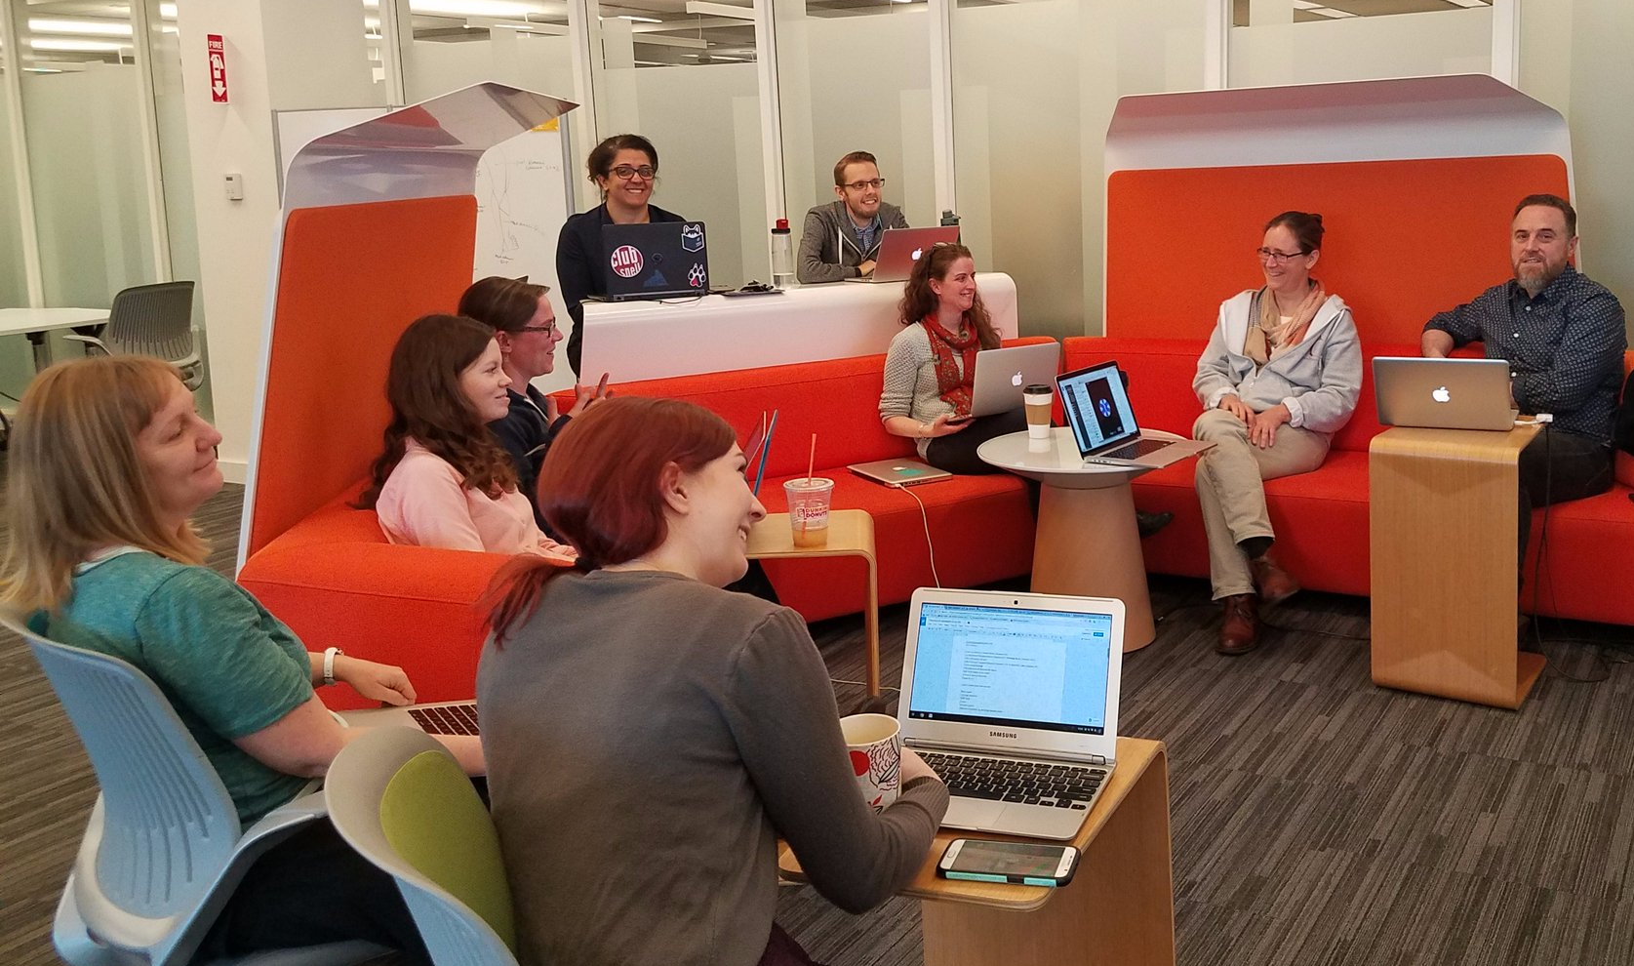
Who We Are
Northeastern University Libraries, Digital Scholarship Group
Text analysis and encoding
GIS
Data visualization
Data management
Repository services
Copyright guidance
Semantic web services

Slide 6
System
Create a sustainable and shareable digital project environment.
Build tools that could support many types of digital research materials.
Encouraging projects to become stewards of their own content.
Secure digital materials in the DRS and web-based projects on library servers.
Project Site
Project Site
Project Site
CERES WordPress Plugin
Data Source
Data Source

Slide 7

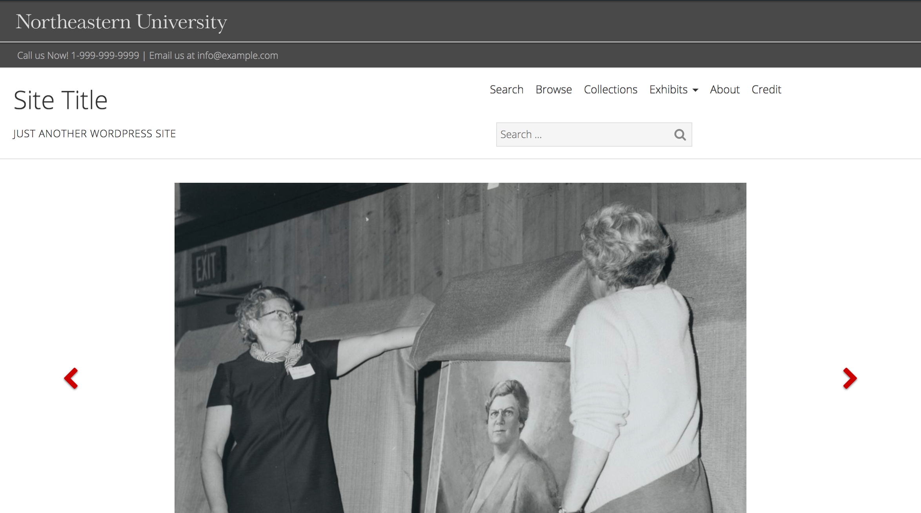
System

Slide 8
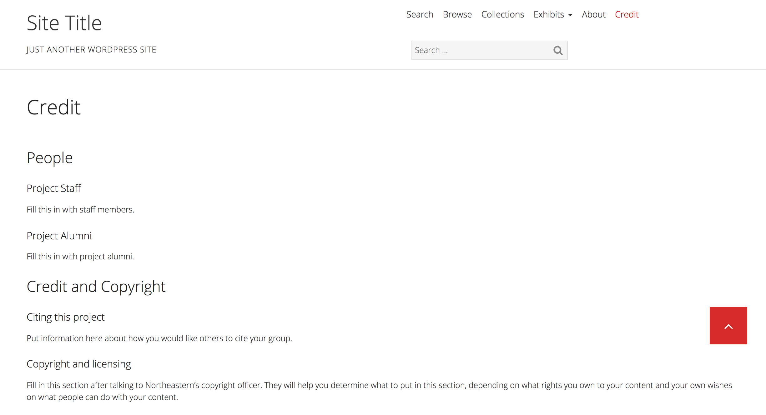
System

Slide 9
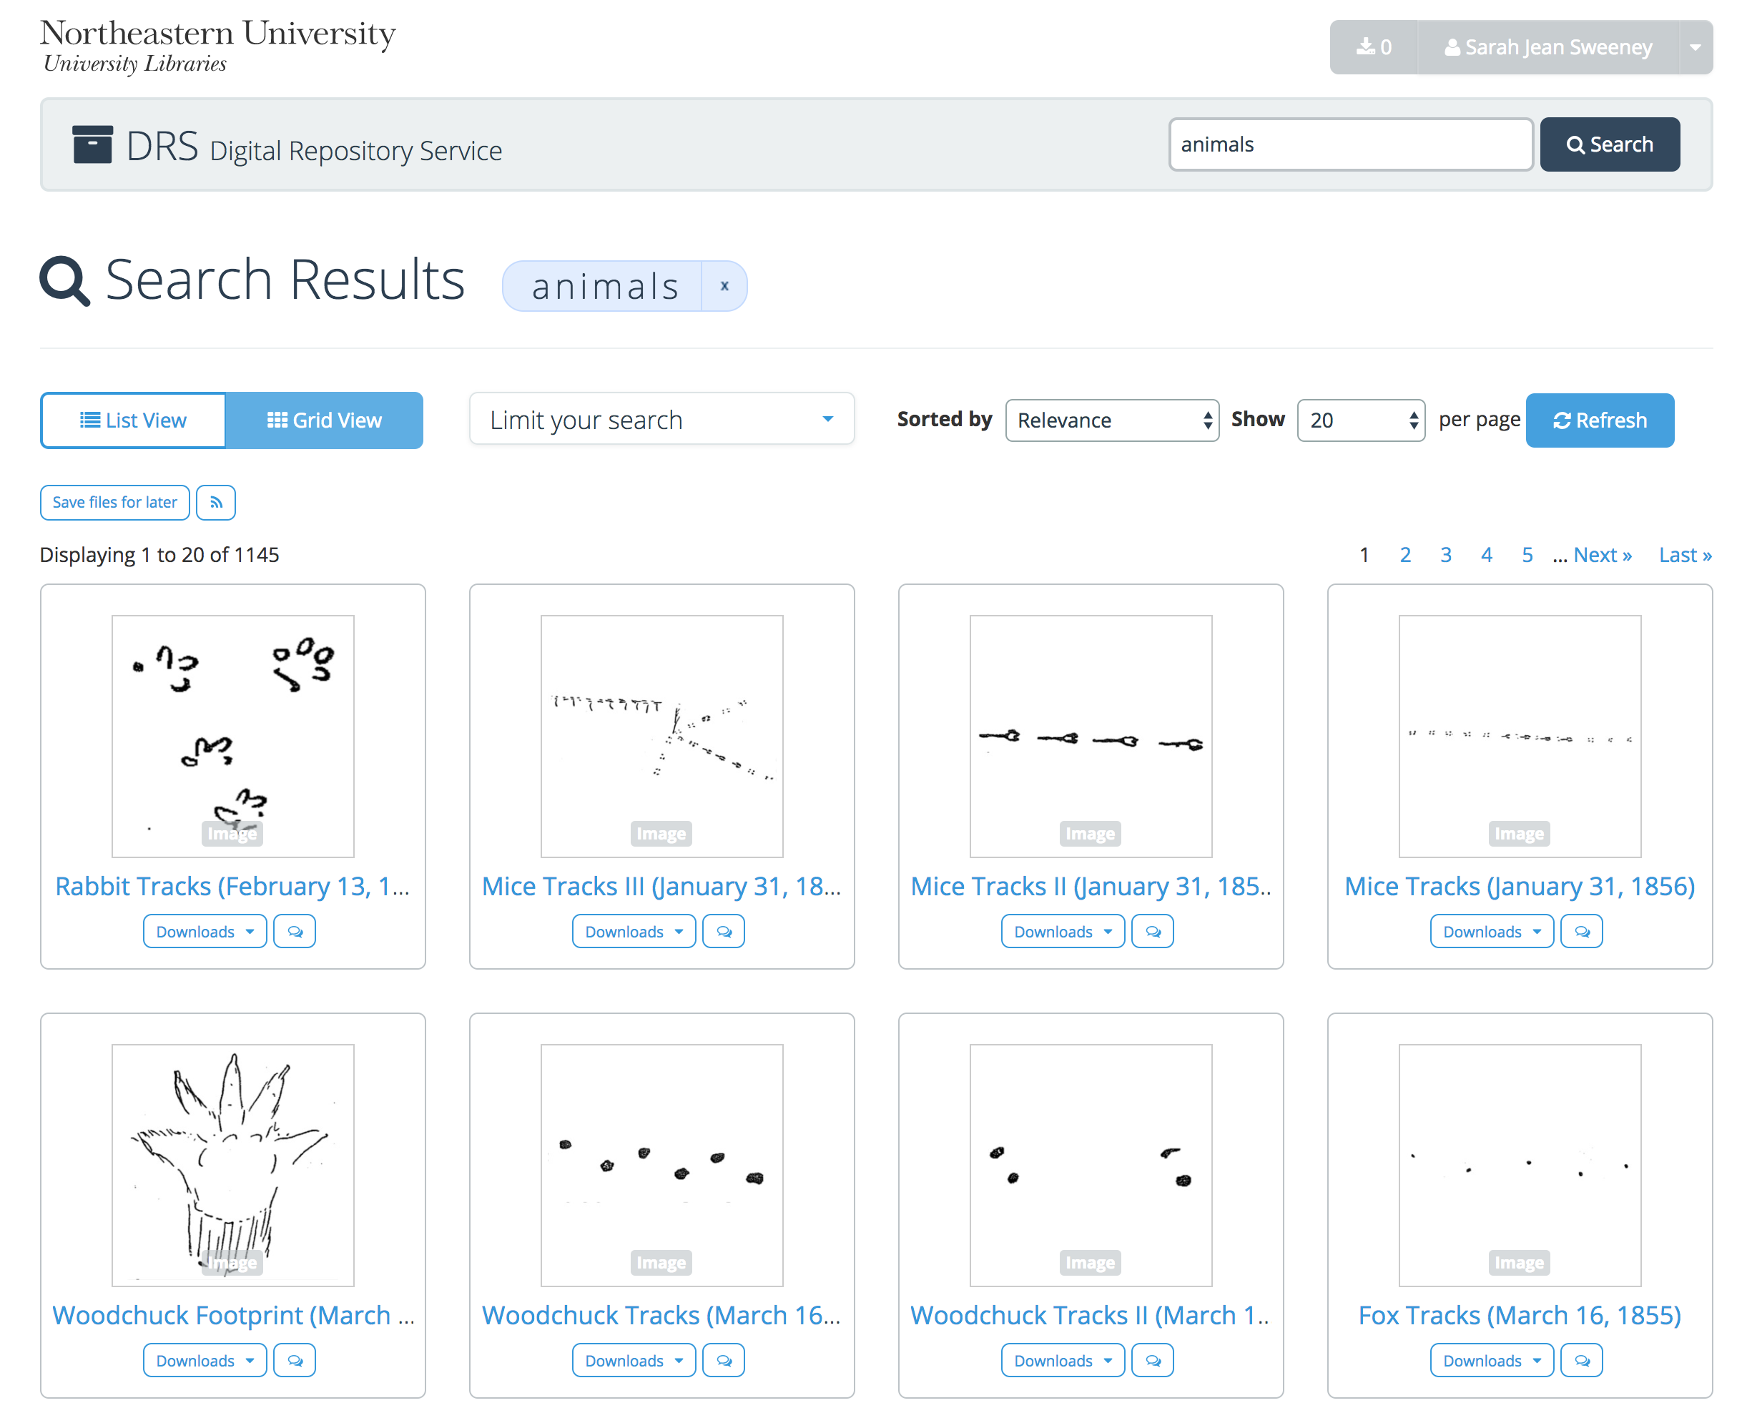
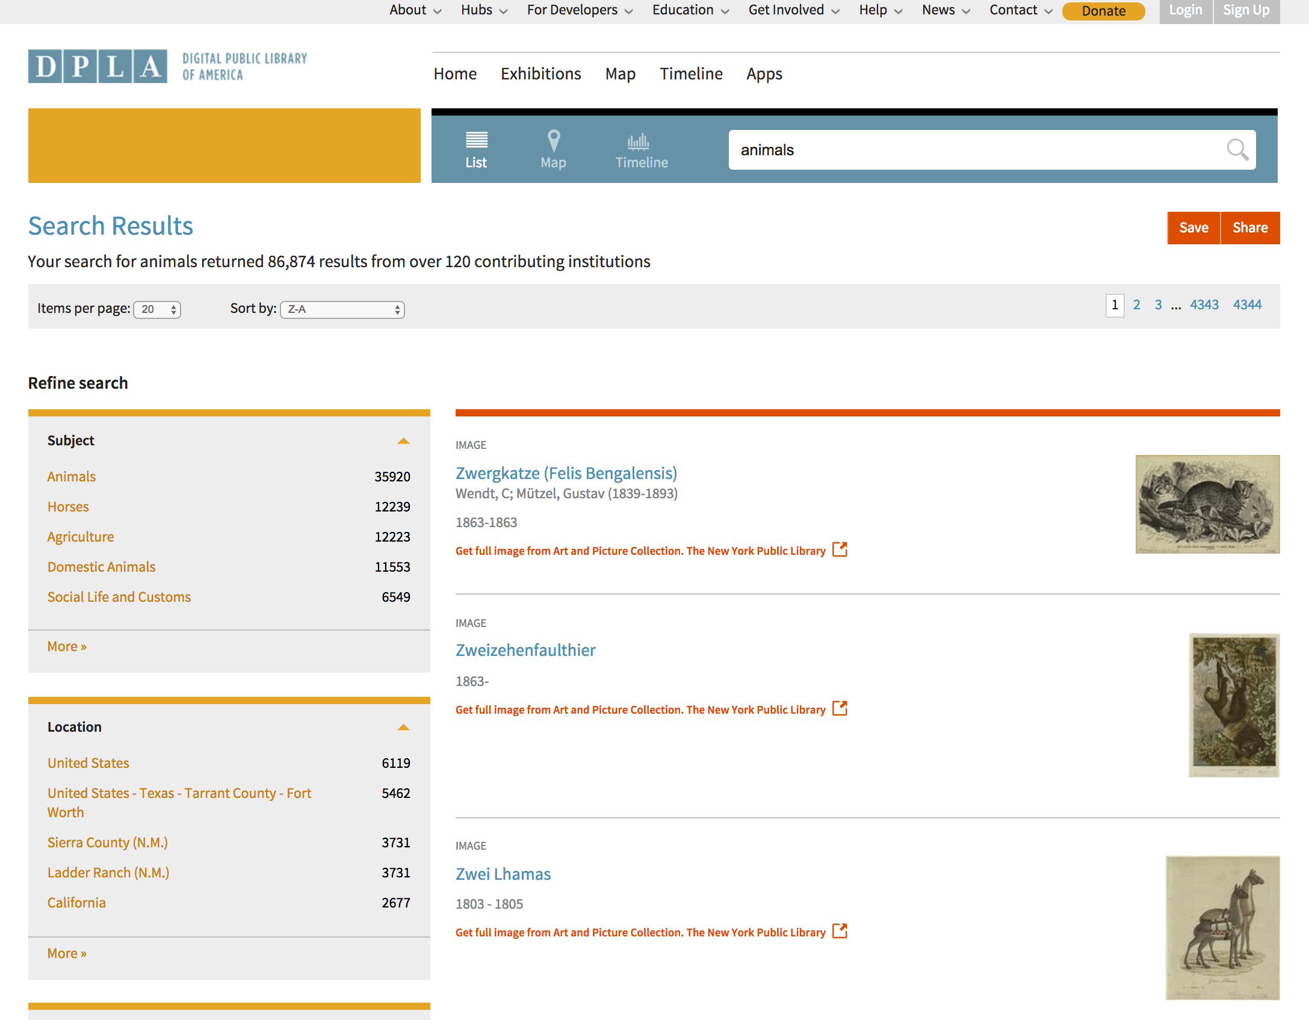
Data Sources

Slide 10
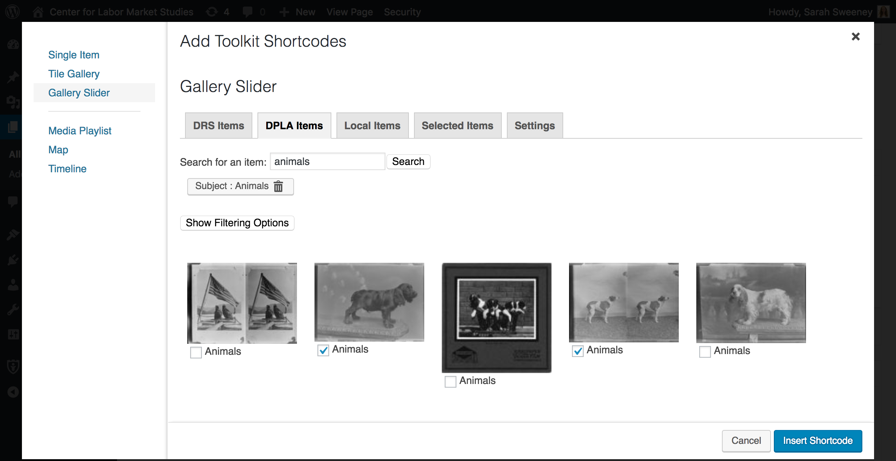
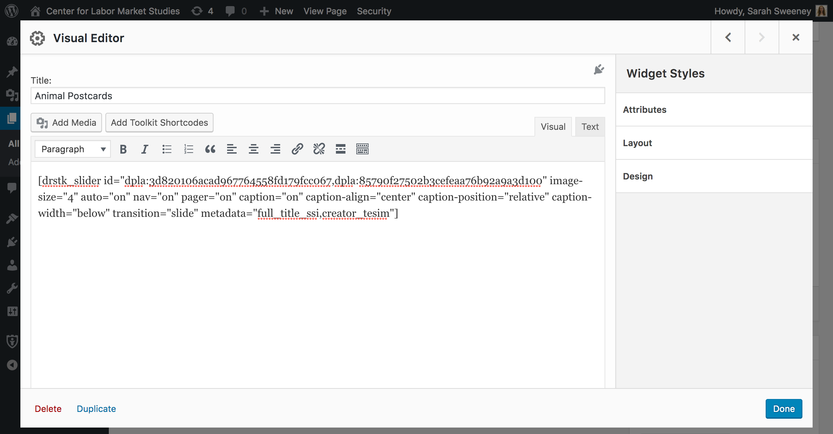
Building Exhibits

Slide 11
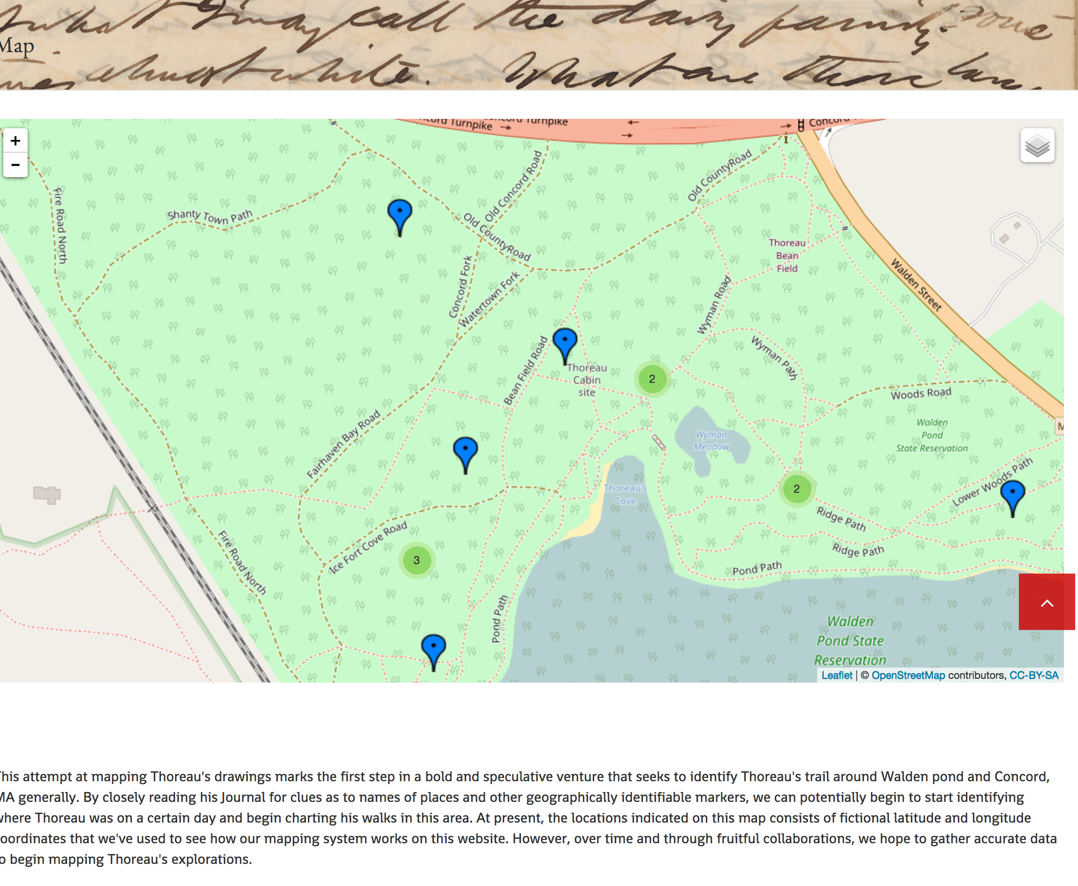
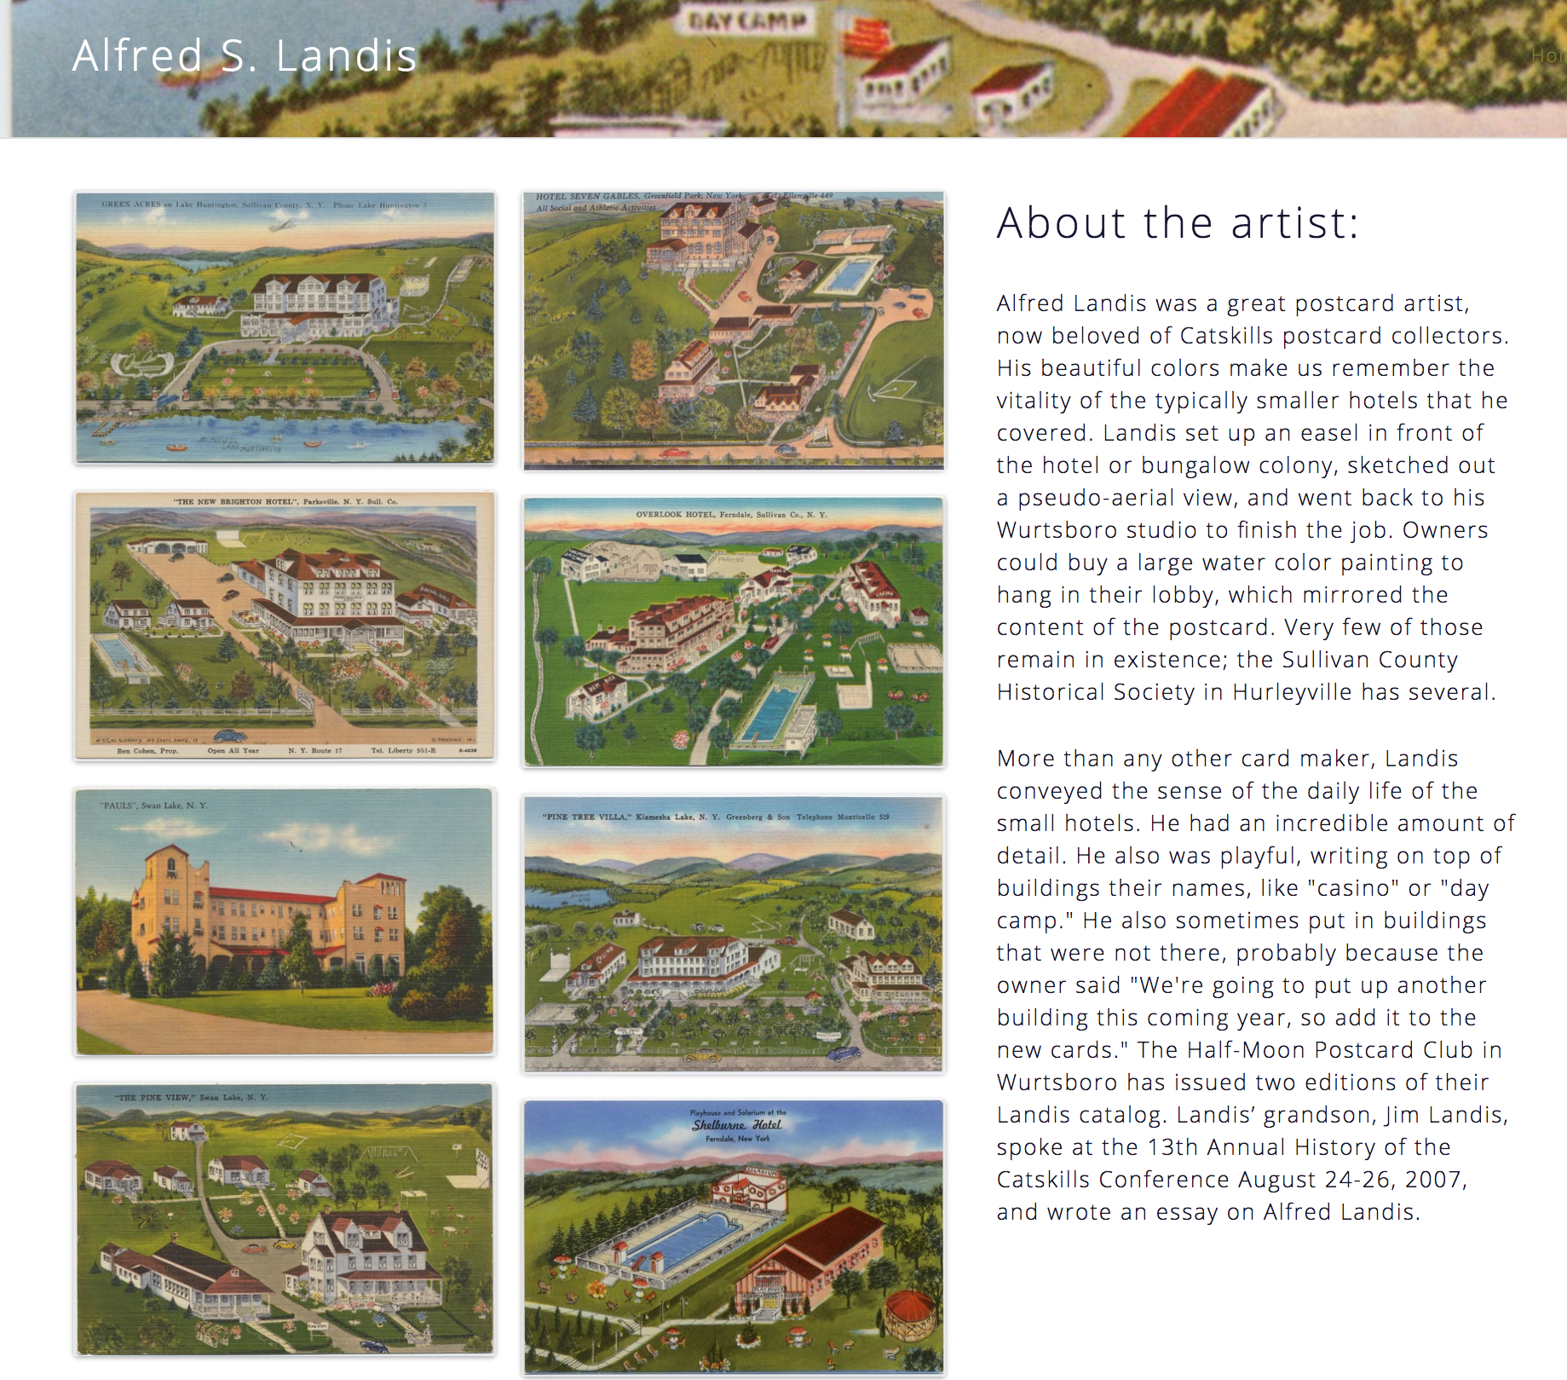
Building Exhibits

Slide 12
Workflow
Annual Check-in
All DSG Projects Must:
Submit a project proposal
Participate in an intake interview
Write a data management plan
Participate in an annual check-in meeting.
Data Management Plan
Intake Interview
Project Proposal

Slide 13
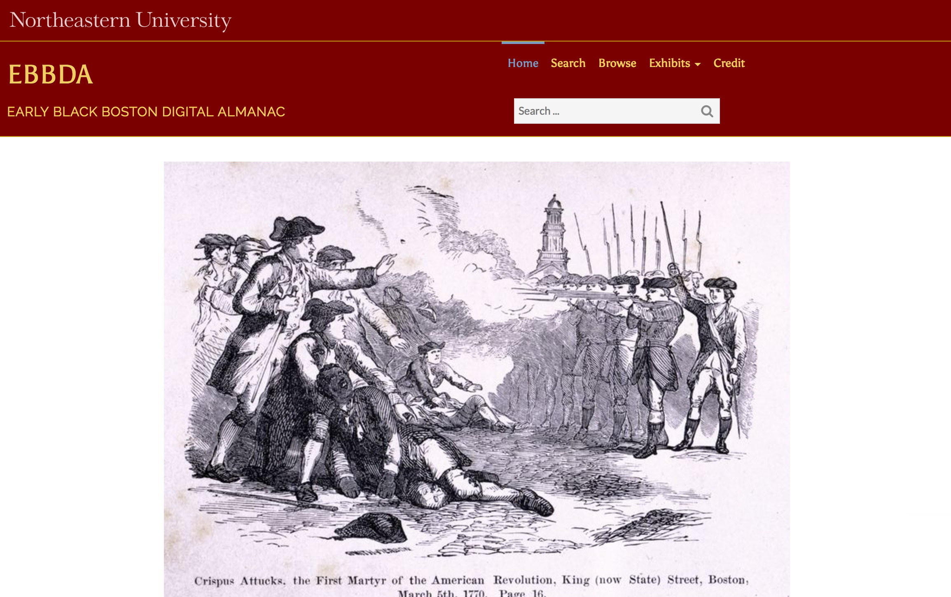
CERES Projects
Early Black Digital Almanac

Slide 14
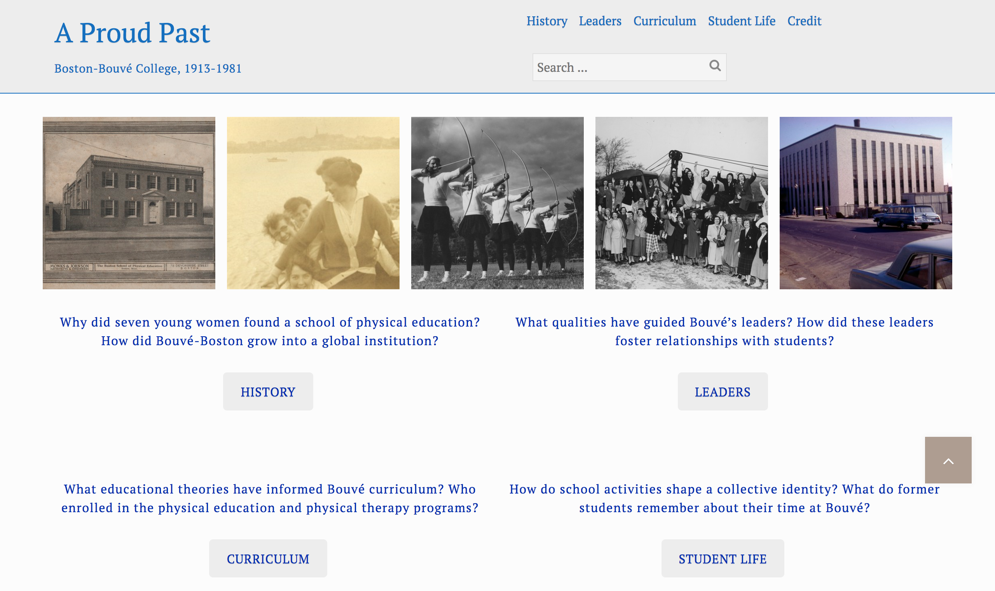
CERES Projects
A Proud Past: Boston-Bouvé College, 1913-1981

Slide 15
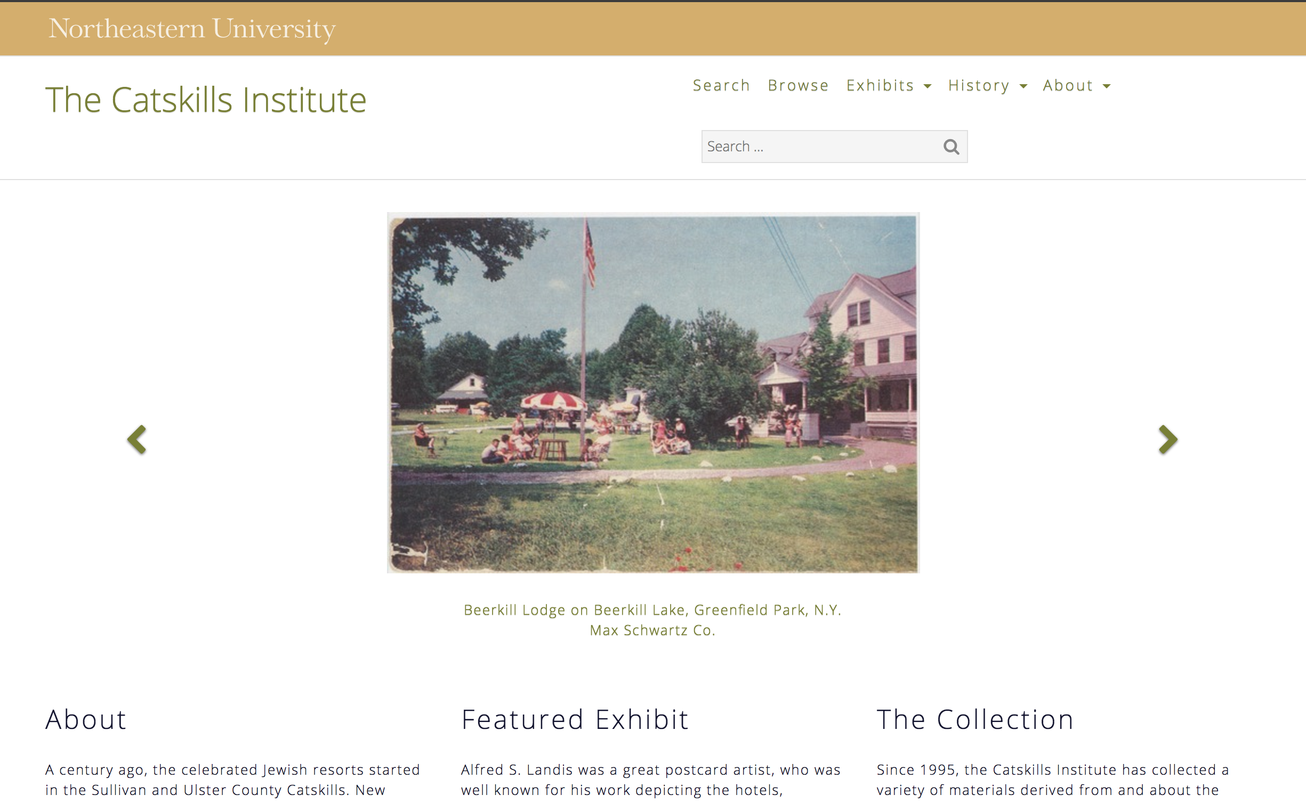
CERES Projects
A Proud Past: Boston-Bouvé College, 1913-1981

Slide 16
Questions?
Resources
Contact

